Slide 1
Remote sensing image classification using R

Slide 2
Outline
Image classification approaches - computer-aided classification
- Maximum Likelihood
- CART (Classification and regression trees)
- Random Forest Algorithm
- Various neural networks
R Caret package
2. Accuracy assessment
- cross validation
3. Case studies

Slide 3
Maximum Likelihood Classification
Assumptions: DN values
for each class are normally
distributed
Class mean
Standard deviation
μ-3σ μ-2σ μ-σ μ μ+σ μ+2σ μ+3σ
68.3%
95.5%
99.7%
If a pixel falls outside the range of (μ+/-3σ), we can say that the probability that this pixel belongs
to the class is 0.3%, or we can say we are 99.7% sure that this pixels does not belong to this class.

Slide 4
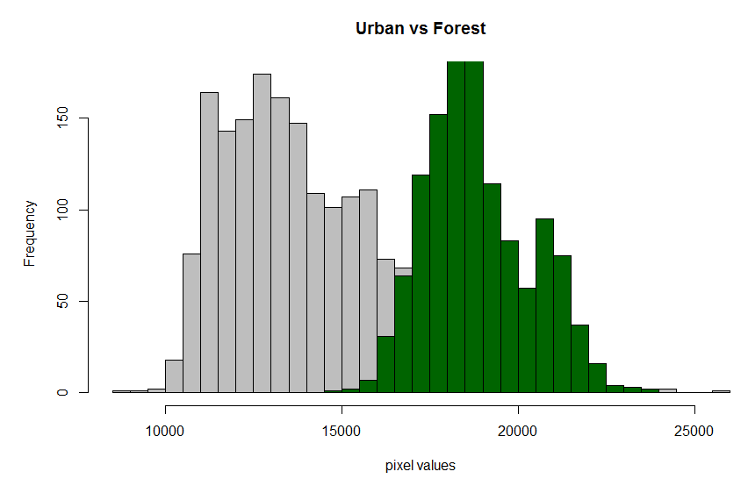

Slide 5
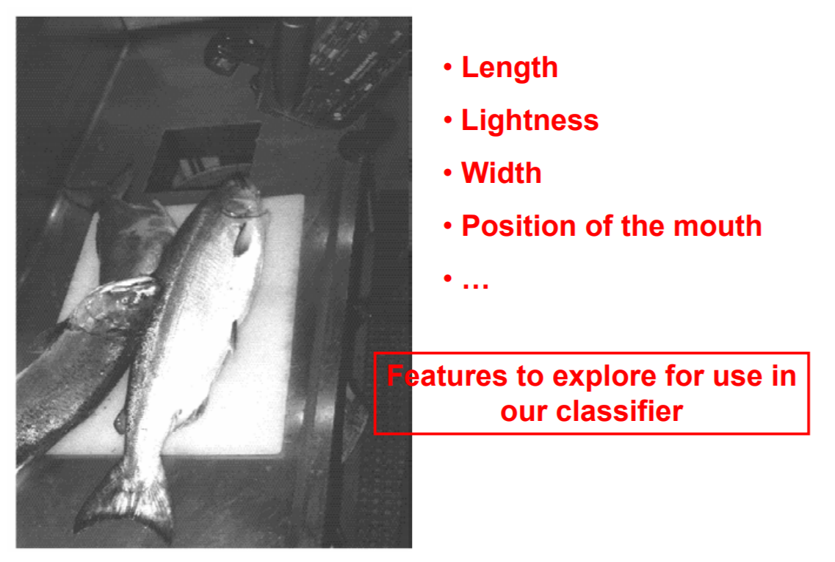
Separate sea bass from salmon using optical sensing
Pattern Classification by Duda & Hart & Stork – Second Edition, 2001

Slide 6
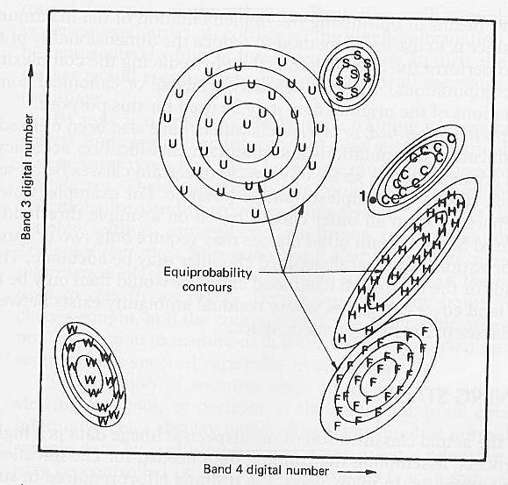
Maximum Likelihood Classification
In a two dimensional spectral space, each class form a probability density region,
the probability for a pixel belongs to a center category is defined by its distance
measured in standard deviation. The pixel is assigned a class that is most likely
(maximum likelihood).
Disadvantages: data follow normal distribution?

Slide 7
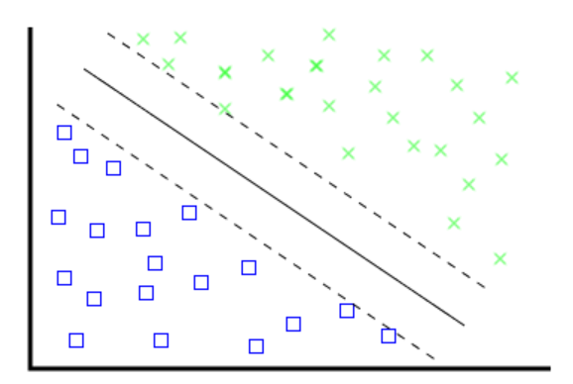
Test different image classification algorithms
Forest
Non-forest
Neural Networks
Classification and Regression Tree
Random Forest
Support Vector Machine
Weights
Weights
Band4
Band1
Band2
…．
Band3
Band4
Band4>95
Class1
Class2
Band3<50
CART
SVM

Slide 8

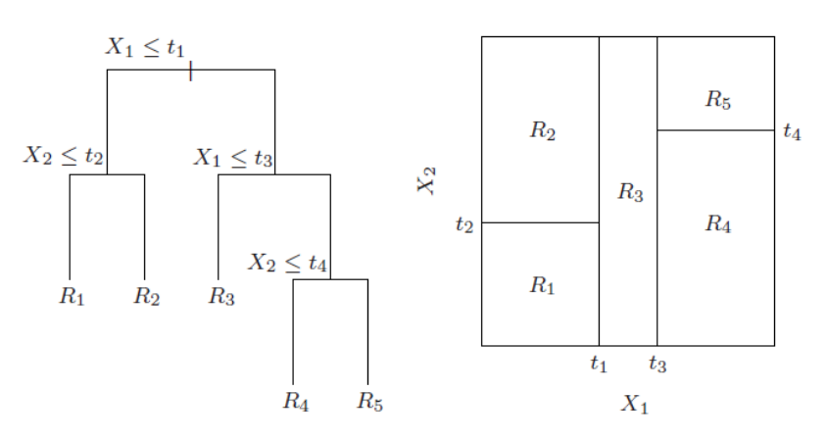
CART (Classification and regression trees)
We do classification by growing a binary tree. Partition the space into smaller regions, where the interactions are more manageable.
Band4
No
yes
Band4>18000
Urban
Forest
Developed by Brieman, Freidman, Olshen, and Stone. It can be generated through the rpart package

Slide 9
Tree-growing Strategies
Ideally, we hope that within each region, there are observations from only 1 class (prefect purity). If not, try to make the impurity small.
Gini index, entropy, ..for impurity measure
At each node, we first select the best possible split for each variable, and then select the variable which minimizes the total (weighted) impurity of the daughter nodes

Slide 10
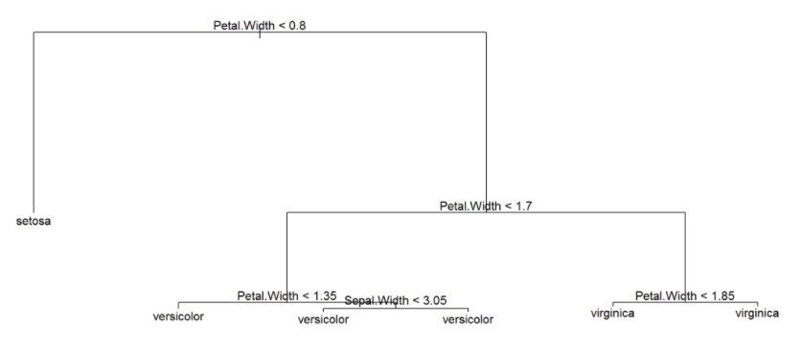
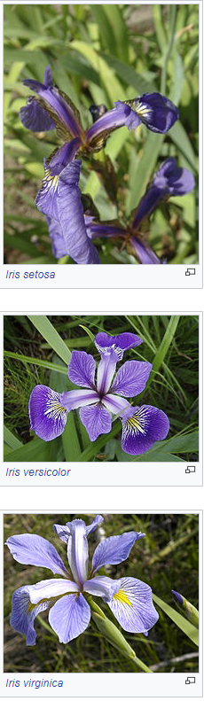
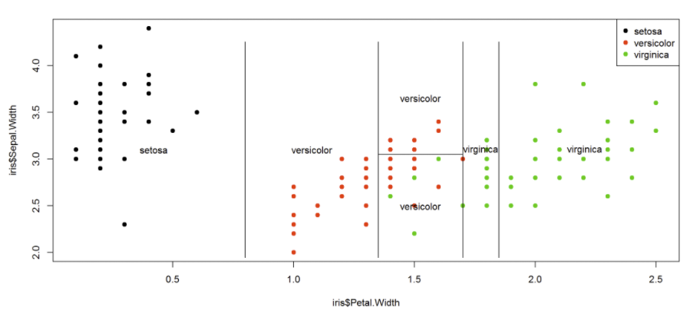
Iris flower data set
Source: http://www.di.fc.ul.pt/~jpn/r/tree/tree.html

Slide 11
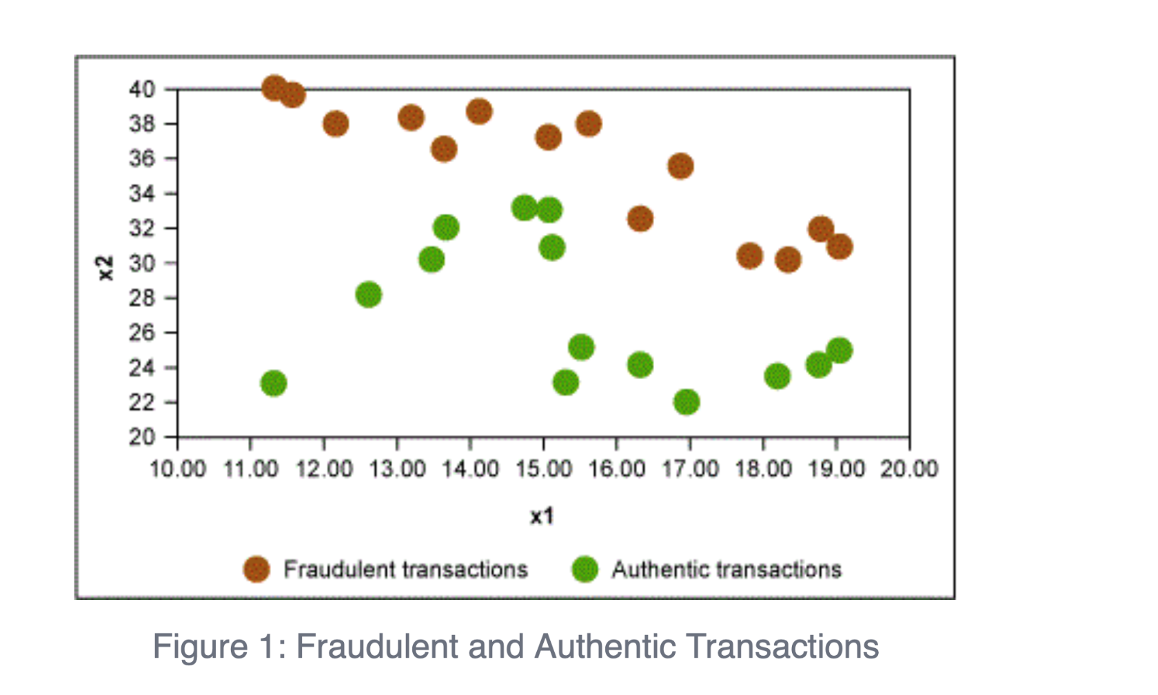
X1: amount of transaction
X2: age of customer
Source: https://www.isixsigma.com/methodology/lean-methodology/use-a-classification-and-regression-tree-cart-for-quick-data-insights/
Notes:
Age over 35 1st group, second group amount less than $16, 3rd group less than 26 age

Slide 12
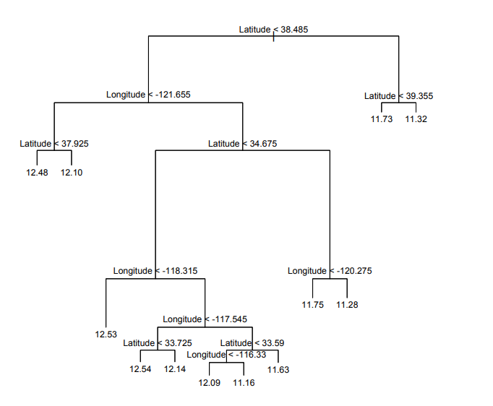
CART for regression
California Real Estate

Slide 13
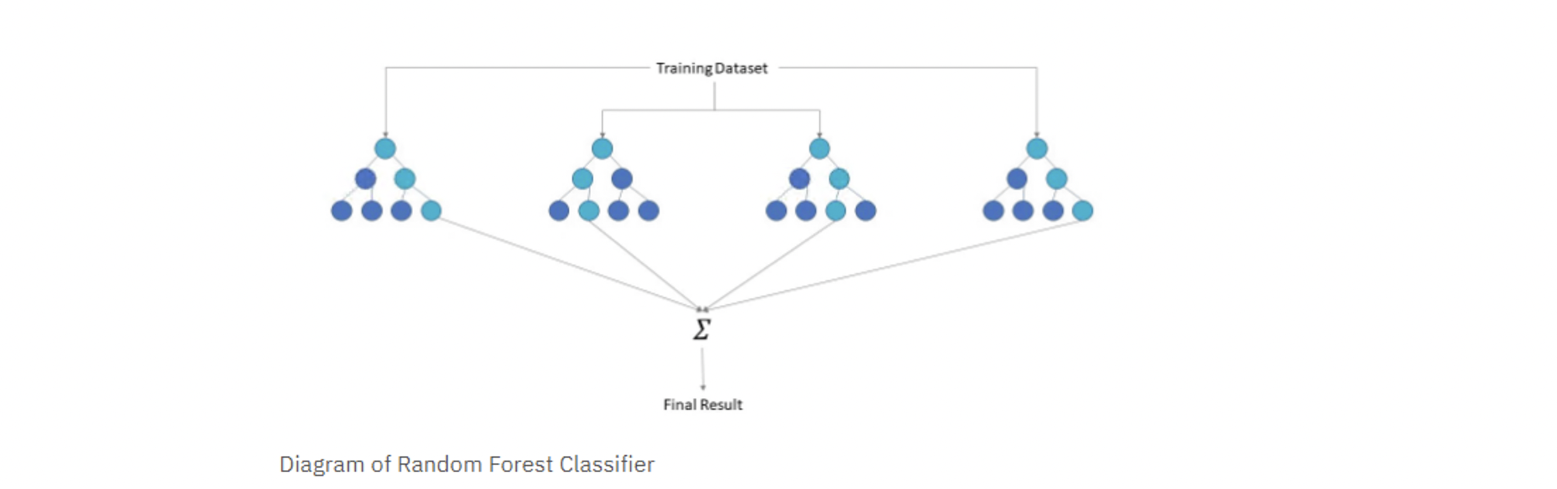
Random Forest Algorithm
(Developed by Leo Breiman and Adele Cutler)
Image source: IBM cloud learning hub
A collection of decision trees
Each tree generates prediction and final results are based on voting (or average)
Each tree uses a data sample drawn from a training set with replacement, called the bootstrap sample
Each tree uses a random subset of features (e.g., select 2 out of 6 spectral bands)
Uncorrelated
trees

Slide 14
Neural Network Classification Approach (Non-parametric)
Neural network does not assume normality for the training sets. It is learning based.
Ag
Non-Ag
Weights
Weights
Band1
Band2
…．
Band3
Band6

Slide 15

Caret package
https://topepo.github.io/caret/

Slide 16

Numerous machine learning methods

Slide 17
Caret Demo

Slide 18
Outline
Image classification approaches - computer-aided classification
- Maximum Likelihood
- CART (Classification and regression trees)
- Random Forest Algorithm
- Various neural networks
R Caret package
2. Accuracy assessment
- cross validation
3. Case studies

Slide 19
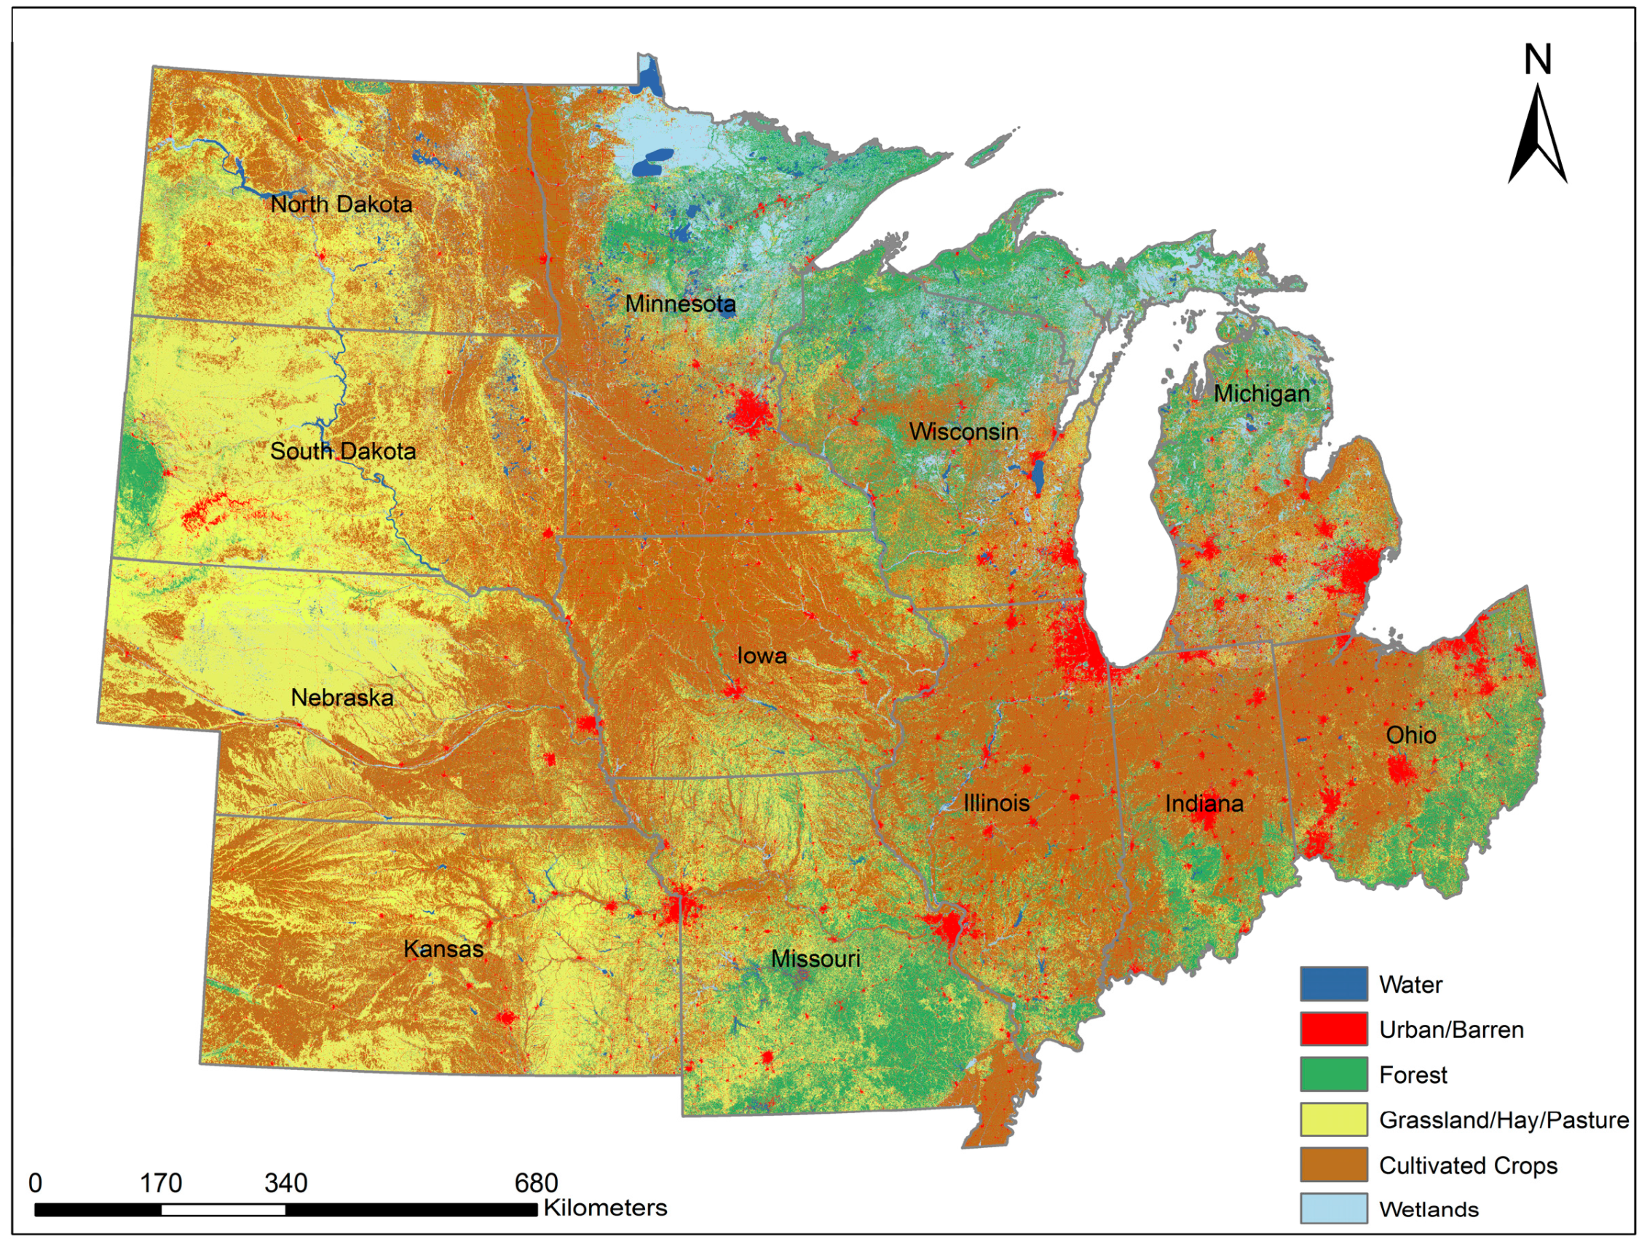
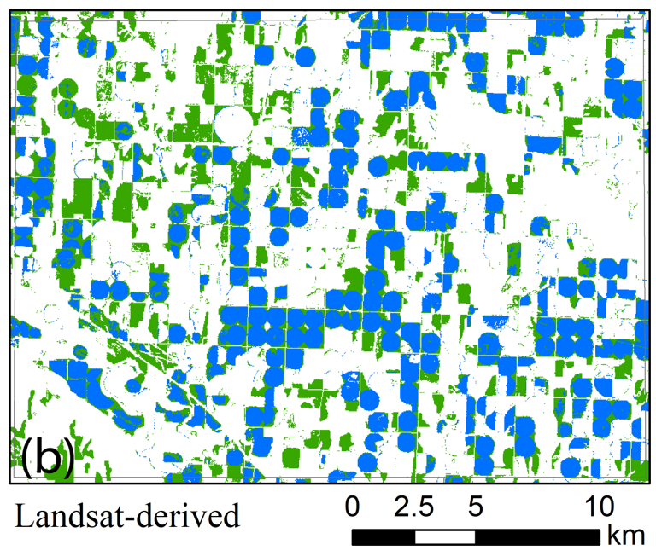
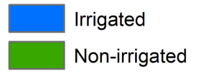
Mapping irrigated cropland (30m) at annual scale
Timely and reliable information on irrigation distribution is important for crop water use calculation, crop yield estimation, watershed modelling, and studies of water, energy and food security.
Main challenges for irrigation mapping:
The availability of training data
The quality of remote sensing data
(e.g. missing data or observation sparsity)
Methods of automation

Slide 20
The classification results for individual ARD images
were gap-filled to generate irrigated and non-irrigated corn map
Landsat ARD images acquired for September 1, August 9, and July 24, 2012 and their overlay view are shown in Figures (a-d)

Slide 21

Annual irrigation mapping (2012-2018)
3145 Landsat ARD images
- Neural network
Random forest
Support vector machine
Overall accuracy ranged from 79% - 90% across mapping years
Collaborators for this project: Jie Ren, Heng Wan, Yanhua Xie, and Adam Campos

Slide 22
Final results of irrigated and non-irrigated corn

Slide 23
Accuracy assessment : 450 randomly selected pixels
 | Reference (2012)
 | MLP |  | RF |  | SVM
 | Ir | NIr | Ir | NIr | Ir | NIr
Ir | 197 | 26 | 200 | 30 | 195 | 22
NIr | 21 | 206 | 18 | 202 | 23 | 210
 | OA: 89.6% |  | OA: 89.3% |  | OA: 90.0%
 | UA:88.3% ; PA: 90.4% |  | UA:87.0%; PA: 91.7% |  | UA:89.9%;PA: 89.4%
Note: OA = overall accuracy; UA = user’s accuracy of irrigation;
PA = producer’s accuracy of irrigation; Ir = irrigation; NIr = non-irrigation.
The Google Earth’s very High-Resolution Imagery Archive as reference

Slide 24
Land cover mapping – Huadong Region, China
Satellite data: Landsat 8, 30m resolution
Annual mapping: 2010-2020
Land cover classification scheme:
Urban, agricultural land, forest, water,
grassland, wetland.
Potential use of land cover map products:
Support high resolution weather forecasting (e.g., high resolution WRF model, Shanghai Meteorological Bureau)
Regional ecosystem monitoring and assessment
Carbon stock and flow assessments

Slide 25
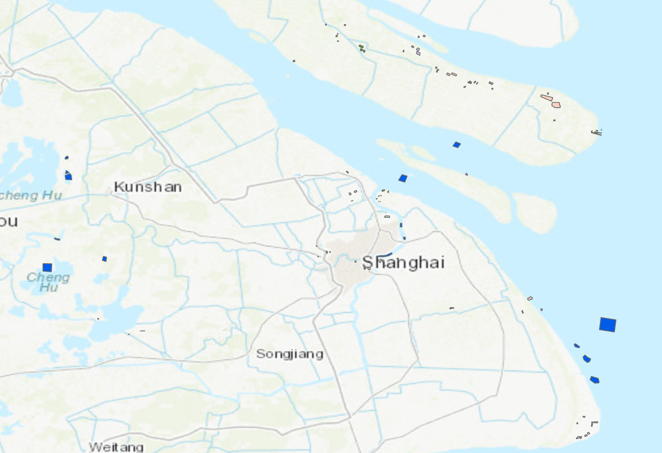
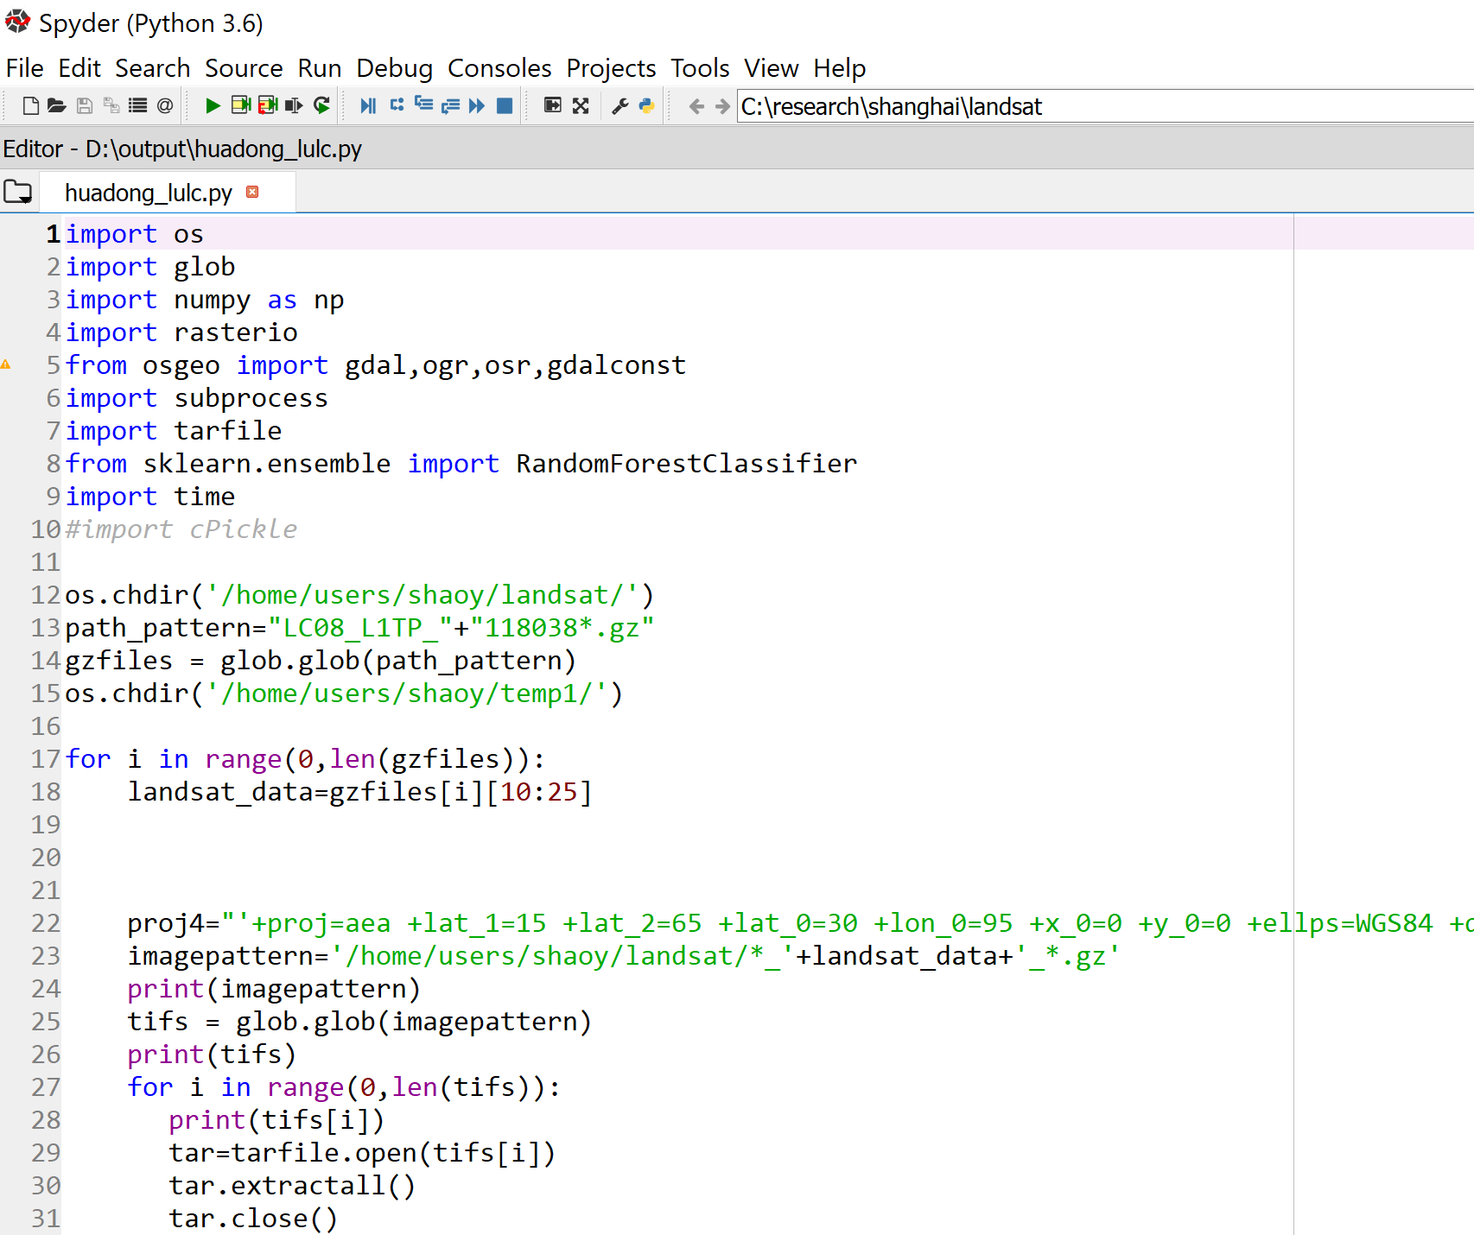
Training data and algorithm development
Automated workflow: Unzipping landsat images; Matching training polygon;
Train random forest classifier; Classify all pixels and create final map products (TIFF format)

Slide 26
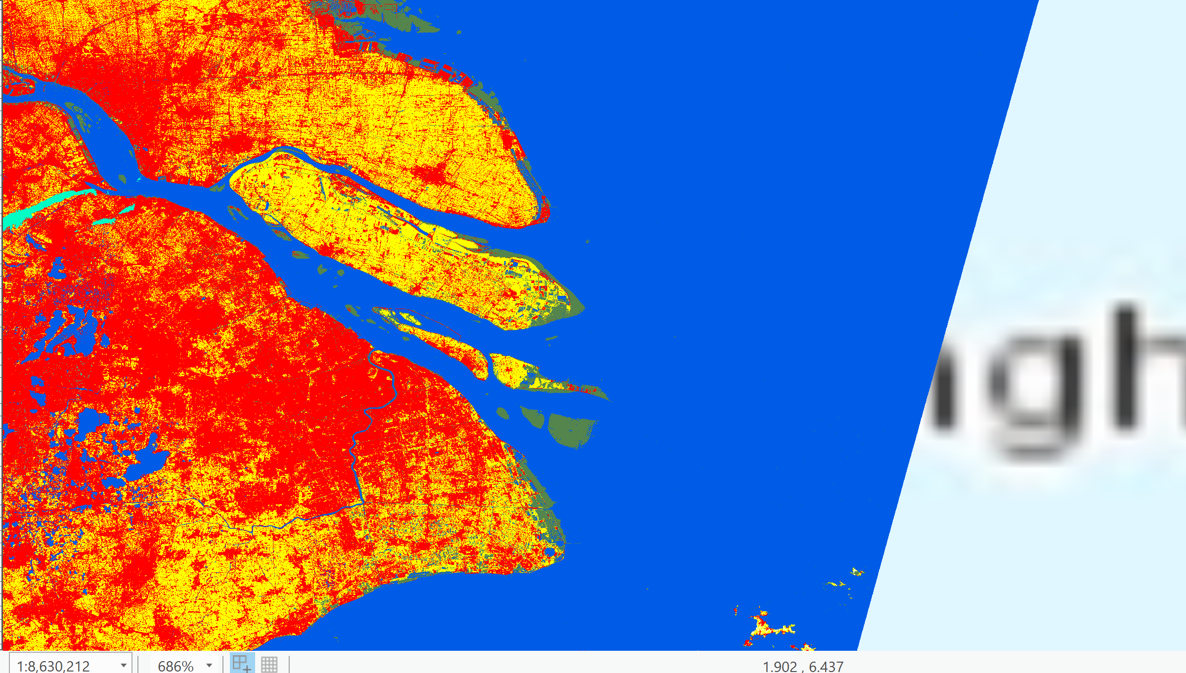
30m resolution Map products (version 1)
Land cover map 2016

Slide 27
Caret for lab5 image classification?

